Slide 1
DAP Lead Auditor Training
Day 4
March 10, 2017 – Revision 3b
For questions or comments, please contact DAP Performance Enhancement Team

Slide 2
Course Agenda recap
Day | Topics
1 | Overview of the DAP Program & Requirements Your Case Study Assignment ISO/IEC 17025 – Introduction DAP Management Requirements (ISO/IEC 17025, Section 4)
2 | DAP Technical Requirements (ISO/IEC 17025, Section 5) Audit Overview and Client Deliverables Planning for the DAP Audit Conducting an Opening Meeting
3 | Conducting an Opening Meeting (continuation) Documenting the DAP Audit using the GALO, In-House Calibration Checklists & Path Notes Laboratory Audit Communicating Potential NCRs to the Auditee
4 | Writing NCRs How to Write a Audit Report Conducting a Closing Meeting Post Audit Responsibilities & Review of NCR Responses DAP Audit Review and Project Completion DAP Inactivation Power Quality Analysis Determination Lead Auditor Course Summary CAP (Certificated Agency Program)
Slide <number>
Notes:
Based on your feedback, we will discuss in summary or in detail. So we need you to speak up when you need clarification.
This class will be tailored to YOUR needs.

Slide 3
Learning Objectives – Day 4
Write effective NCRs
Complete audit report
Conduct a closing meeting
Completing Post-audit tasks to keep the project moving
Evaluate client NCR responses
Explain the purpose of DAP reviews & see their content
Identify reasons for and required steps for Inactivations
Explain the process for reinstatement
Understanding the Power Quality Analysis requirement
  DAP Assessment and Nonconformity Procedure
  (00-OP-S0056)
Slide <number>

Slide 4
Writing NCRs
Module 11

Slide 5
Learning Objectives
Explain what causes a nonconformity
Describe key components of an NCR
Identify the main features of an NCR report form
Write an NCR successfully using the DAP Assessment Tool
Slide <number>

Slide 6
What Can Cause a Non-Conformity?
Current lab practice does not comply with requirement (internal or external).
Current implementation used to comply with requirement is not effective.
Requirements include:
  Test Standard
  Participant’s quality manual, procedure, form
  DAP requirement, client guide
Slide <number>
Notes:
Possible causes of a nonconformance:
Noncompliance to a requirement (internal or external)
Documentation or observed lab practice does not meet the requirement
The client lab has not effectively implemented a process to comply with a requirement
NOTE: Refer class to the “real-life findings” discussed at the end of each ISO/IEC 17025 clause. Discuss examples of what you have observed during your DAP audits.

Slide 7
Components of an NCR
3 Key components:
      Requirement - Expectation
      Nonconformity - The problem itself, the gap
      Objective Evidence - What was reviewed that showed nonconformance to the requirement.
  The NCR needs to stand alone for all parties to understand consistently.
Slide <number>
Notes:
NCRs should be written in 3 parts.
If written correctly, the client should be able to fully understand the finding and further investigate it.
Remember, it helps to have discussed the NCR with the lab as soon as it was discovered.

Slide 8
Specifics about Requirement
Sets the expectation
Use actual phrases from the applicable standard or document
    DAP Assessment Tool automatically populates the NCR report form using exact wording from ISO/IEC 17025.
Reference number and clause
    ISO/IEC 17025 clause
    DAP client guide number
    Standard number, edition, and clause
    Client’s procedure or form number and revision level
Slide <number>
Notes:
Auditors need to make sure they reference the correct requirement.
Exact wording from the standard or document will lower the possibility of misinterpretation and client challenges.
We always need to be able to trace the NCR back to a requirement. If an auditor cannot do this, they need to revisit whether or not they really have an NCR or not.
It is also important to reference procedure and standard numbers and clause numbers. You want to point the client and other UL staff (DAP reviewers) to the exact requirements.
Activity: Choose a “real-life finding” to write an NCR so the class has an example before they write their own.
Use flipchart to record 3 key components of the NCR (requirement, nonconformity statement, objective evidence).

Slide 9
Specifics about the Nonconformity
Describes the problem that needs to be addressed:
    What is the issue?
    What part of the requirement does it not meet?
    NO corrective action statements - Do not provide suggestions to achieve compliance.
Slide <number>
Notes:
Discuss the importance of referencing the issue back to the specific requirement of the standard.
Activity: Choose a “real-life finding” to write an NCR so the class has an example before they write their own.
Use flipchart to record 3 key components of the NCR (requirement, nonconformity statement, objective evidence).

Slide 10
Specifics about Objective Evidence
Give detailed information so it can be investigated – when where, what etc.
  Example: The daily temperature log in the motor lab indicated a reading of 85 degrees on 6/10/11.
  Example: Lab records, in the motor lab, the week of June 8th, indicated environmental conditions (temp/humidity) were exceeded 4 times.
Sample size – how often
  Example: 4 out of 10 temperature records reviewed indicated the maximum temperature reading had been exceeded – with no action taken.
Slide <number>
Notes:
Activity: Choose a “real-life finding” to write an NCR so the class has an example before they write their own.
Use flipchart to record 3 key components of the NCR (requirement, nonconformity statement, objective evidence).

Slide 11
NCR TYPES - Finding
Finding– Nonconformance to a requirement or procedure that is at least one of these:
  Systemic - affecting entire process or laboratory
  Recurring - multiple instances of found nonconformance
  Severe - test data submitted to UL could be suspect
  NOTE: Root Cause Analysis summary & root cause statement is required
  DAP Assessment and Nonconformity Procedure
  (00-OP-S0056, Issue 12)
Slide <number>
Notes:
00-OP-S0056 has been revised to mimic UL’s internal quality system of defining actions required by the auditee.
Moving forward, we will classify an NCR as Requiring Corrective Action that is a nonconformance to at least one of these [go through bullets and ask audience for real life examples to discuss].
Issue 11 of the 00-OP-S0056 is in doc control for approval.

Slide 12
NCR TYPES - Observation
Observation – Nonconformance that does not appear to be systemic, recurring or severe.
- No analysis or root cause needed
- Need only fix the occurrence
Examples
  Calibration supplier XYZ Inc. is accredited to the measurements calibrated but did not provide the accredited logo or 4 statements on cal cert 43ABC dated 2015-03-03.
  1 out of X datasheets reviewed did not contain a required date.
  Procedure SOP-120, rev 3 did not define the lab’s current and appropriate practice for electronic data back-up.
  DAP Assessment and Nonconformity Procedure
  (00-OP-S0056, Issue 12)
Slide <number>
Notes:
Discuss the new definition for classifying an NCR as Observation.
Read examples.

Slide 13
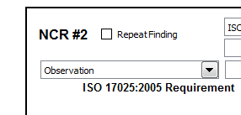
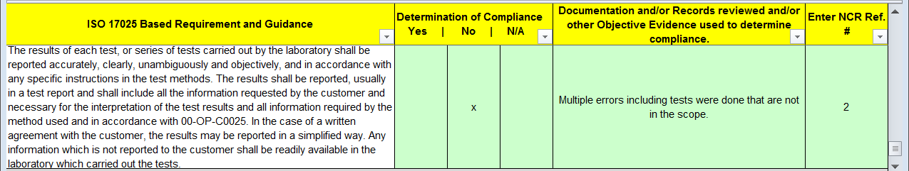
Use DAP Assessment Tool (00-OP-F0031) to write NCRs
Nonconformity Reports tab: Select NCR classification
    Finding vs. Observation
GALO or In-house Calibration Checklist tab: Place NCR # in appropriate clause(s).
  Activity – Instructor demo ONLY to create NCR report.
Slide <number>
Notes:
Use DAP Assessment Tool to write an example NCR for the class using statements from flip-chart (previously done).
The class does not need to follow since they will do this in the upcoming activity.
Point out that to identify NCRs, they are given numbers (see “Nonconformity Reports” tab).
Need to classify the NCR as Finding or Observation.
Some clauses repeat in the GALO and In-House Calibration Checklist. Enter the NCR# where it the clause was written against AND either:
Enter NCR in the reference column or comment column where for clauses/rows where the requirement is repeated.
Where an NCR is issued, determination of compliance is marked “No”.
Stress that consistency is very important across all reports.

Slide 14
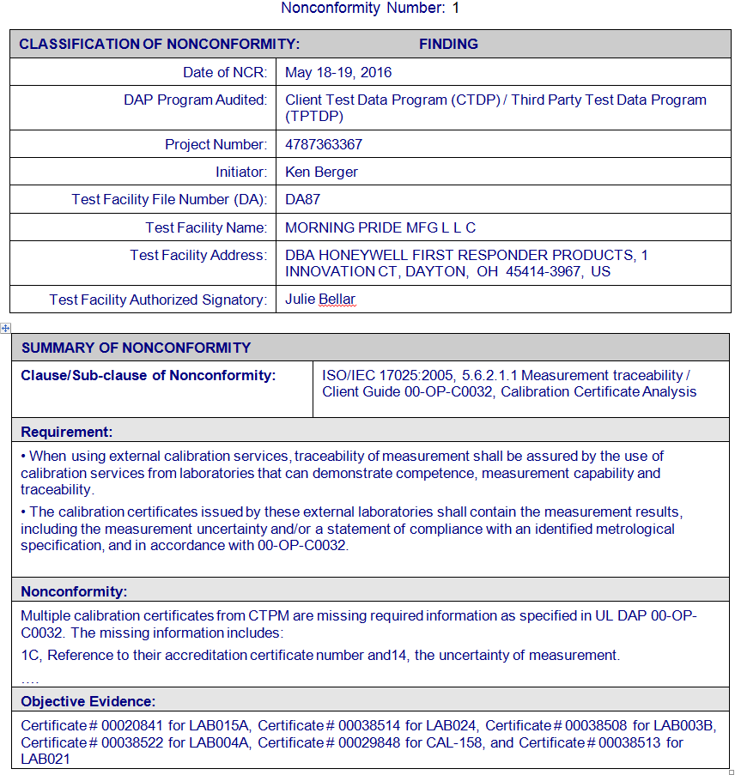
DAP Assessment Tool Creates NCR Report
Header
  Classification and NCR #
  Participant, audit info
Summary of
Nonconformity
  17025 clause/sub-clause/ standard/client guide
  Requirement
  Nonconformity
  Objective evidence
Slide <number>
Notes:
Remind class that they will have the opportunity to create their scenario based NCR but do not need laptops at this time.
Discuss the overall form and the various boxes.
Provide examples of what should be contained within each of the sections.
You might also want to give a non-example and ask the class if that should be entered or not. In this way, the class can begin to apply what they are learning.

Slide 15
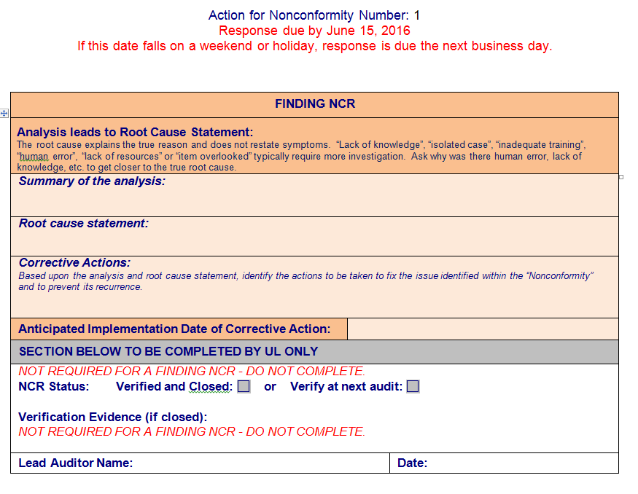
Features of the NCR Report (Finding)
Section completed by client
  Root cause and analysis summary
  Corrective action(s)
  Anticipated date
Section completed by UL
Slide <number>
Notes:
Briefly discuss.
Explain that actual examples and evaluation of NCRs will be discussed later.

Slide 16
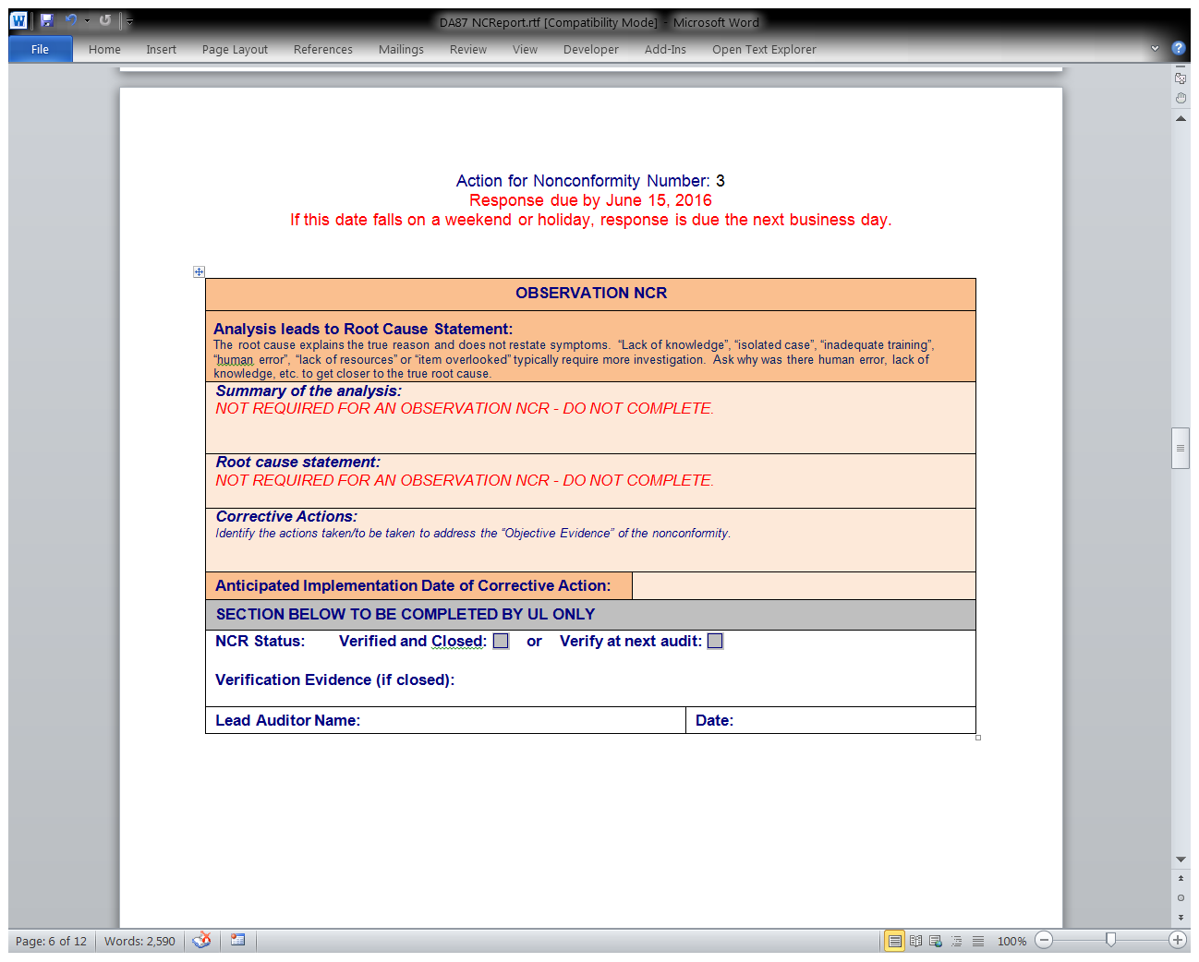

Features of the NCR Report (Observation)
Section completed by client
  Root cause and analysis summary
  Corrective action(s)
  Anticipated date
Section completed by UL
Slide <number>
Notes:
Briefly discuss.
Explain that actual examples and evaluation of NCRs will be discussed later.

Slide 17
Keys to Writing a Successful NCR
Clear concise statements
        Sufficient information
        Should be actionable
        Details of the issue
        Specific evidence
        Sample size
Tie the nonconformity and objective evidence back to the requirement
Slide <number>
Notes:
Give enough information for client and UL staff to be able to clearly identify and investigate the issue.
Many times, people outside of the audit need to review and investigate NCRs.
Auditors need to keep in mind NCRs must be concise (we should not be writing novels!, especially since we have already communicated the NCRs to the client).

Slide 18
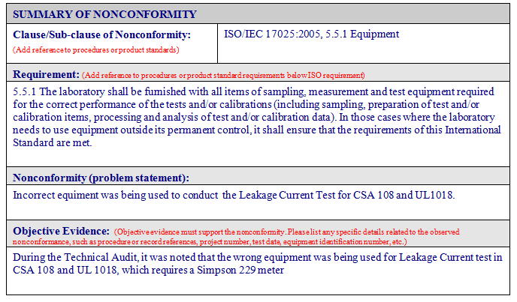
Example NCR – Effectively Written?
Slide <number>
Notes:
ASK: Do you think the nonconformity and objective evidence statements in the examples NCR are appropriate? Would you add or remove anything? (Get the class discussing to gauge understanding)
Generally NO because:
Actual meter ID should be included (i.e. Asset number, serial number).
Standard and editions should be included by selecting in the DAP Tool.

Slide 19

Module 11 – Activity 1, Writing an Effective NCR
Directions:
  Use the scenario you had for the role play.
  Instructor demo using flipchart example to write an NCR in DAP Tool “Nonconformity Report” page.
  Write an NCR and email to Instructor. Be sure to:
      Review characteristics of good statements.
      Nonconformity statement is defined well.
      Objective evidence is clear.
      It is actionable.
      Complete all sections.
  Instructor will review at least one NCR for each scenario. Class will offer feedback for everyone’s learning.
Time: Write NCR – 15 minutes
  Review NCRs – 45 minutes
Slide <number>
Notes:
This activity focuses on gaining practice in writing the NCR based on your observations and discussion with lab personnel.
If discussions resulted in no further action, distribute a new scenario to them so they can write the NCR.
ACTIVITY: Walk through creation of an NCReport using the “Nonconformity Report” tab in DAP Assessment tool.
The class has 15 minutes to write their NCR and email it electronically to the instructor so it can be discussed in class.
Answer Key: There is none. Focus the class on:
Choosing the most appropriate clause for their NCR, writing clear and concise nonconformity and objective evidence statements.
Having enough information to make it actionable but not too wordy. Otherwise, it will get confusing for the client.

Slide 20
Repeat Finding
  Repeat Finding – see 00-OP-S0056
  When does the Lead Auditor review last year’s NCRs?
  Finding identified in previous audit for which corrective action has not been completed as planned.
Finding is substantially similar in nature to one in previous audit.
Lead Auditor informs DAP Audit Manager who will review & determine the appropriate action(s).
    NA – Kai Huang AP/EULA - Larisa Aoyagi
DAP Participant will be informed of required actions.
Slide <number>
Notes:
Review definition and steps Lead Auditor takes.

Slide 21

Module Summary
Explain what causes a nonconformity
Describe key components of an NCR
Identify the main features of an NCR report form
Write an NCR successfully using the DAP Assessment Tool
Slide <number>

Slide 22

Questions?
Slide <number>

Slide 23
How to Write a DAP
Audit Report
Module 12

Slide 24
Learning Objectives
List the components that make up a DAP Audit Report
Generate a DAP Audit Report using the DAP Assessment Tool
Slide <number>

Slide 25
DAP Audit Report – Key Components
Cover Page
Assessment Summary
Nonconformities (Findings vs Observation)
Authorized Signatories
Meeting Attendance
Appendix A (NCR Response Process and Inactivation Process)
Post Audit Scope
Slide <number>
Notes:
Activity: Walk through the sample audit report identifying:
Cover Page – Project number, DA file, Client Name/Address, Program, Audit Date, Audit Team Members
Assessment Summary – Summary of the audit and recommendation to continue or suspend participation. We will discuss the key components of the summary on the next slide.
NCRs – Identification of NCRs as findings or observations, association with ISO/IEC17025 Clause , Summary, Review of past NCRs for effective implementation
Authorized Signatories and Meeting Attendance - self explanatory
Appendix A - Defines the timeline and process for responding to NCRs, defines the process when “Inactivation” is recommended by the Audit Team (Inactivations will be covered later).
Post Audit Scope – The list of tests the audit team recommends for participation after the audit is completed.

Slide 26
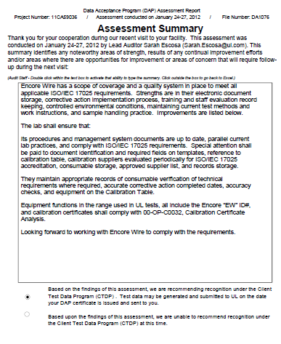
DAP Audit Report – Assessment Summary
Be sure to include:
    Areas of Strength
    Results of any Continuous Improvements
    Opportunities for Improvement
    Areas of Concern
    Select Participation Recommendation
    Important details for THIS audit
Slide <number>
Notes:
Review sample audit report for some examples of the following:
Areas of Strength
Continuous Improvements
Opportunities for Improvements - summarize NCRs issued and other suggestions.
Potential Areas of concerns
A quick snapshot of how the audit went
Be sure to identify the audit team’s recommendation to continue or suspend participation.

Slide 27
Module 12 – Activity 1, Writing an Assessment Summary & Creating the Assessment Report
Directions:
Review the guidelines for effective writing from the Writing NCRs module.
Write the Assessment Summary portion using the case scenario you have been working with.
If you need to, revise your NCR statements.
Discuss your assessment summary with the instructor who will review and provide you feedback.
Generate the DAP Assessment Report to practice using the DAP Assessment Tool
Time:
30 minutes - Individual with one-on-one Instructor feedback
10 minutes - Class Discussion
Slide <number>
Notes:
Indicate that this activity focuses on summarizing how this particular audit went.
Instructor Answer Key:
Since this is an individual activity, there are no specific answers.
Review individual’s summaries one-on-one as they complete them.
Facilitate a discussion of key points when writing the audit report (refer to last slide if needed). Provide any general feedback from your own experience on writing these reports.
Ask the class in general:
What part of writing the summary was the easiest? What was the most difficult?

Slide 28
Module Summary
Main components of a DAP Audit Report
Creating the DAP Audit Report using the DAP Assessment Tool
Slide <number>

Slide 29

Questions?

Slide 30
Conducting a Closing Meeting
Module 13

Slide 31
Learning Objectives
Describe the reasons for a closing meeting
Identify key personnel who should attend and how you document attendance
Describe the required topics covered at a closing meeting
Closing meeting preparation
Explain the appeals process
Conduct a closing meeting
Slide <number>

Slide 32
Reason for a Closing Meeting
Provides a forum to present findings, conclusions and audit team recommendation.
Opportunity to discuss and gain agreement, if appropriate.
Sets expectations for all involved
    Timeline for responding to NCRs
    Create plan to closing audit project by anniversary date (AVD)
Slide <number>
Notes:
Give some real life examples of events that have taken place in closing meetings.
Note why it is important to limit the discussion to a specific timeframe if there are diverging opinions, agree to disagree, indicate the client may appeal a finding/NCR, and move on.
Closing meetings should typically be no longer than 30 minutes.

Slide 33

Who Should Attend the Closing Meeting?
Laboratory Management
The Signatory(ies)
Auditees
“Who will be responding to the NCRs?”
Circulate a sign-in sheet, if needed
Note attendance with titles in the Assessment Report
Slide <number>
Notes:
Discuss that DAP Auditors cannot force the client to have certain attendees, they can only suggest participants.
It is up to the client to decide who will be attending the meeting.
In a rare case, a client may not wish to have a closing meeting.
If applicable, note this in your report and that you discussed NCRs as they came up and provided the client with a copy of the report and NCRs.

Slide 34
Closing Meeting Topics
Thank personnel for allowing UL to perform audit.
Restate audit purpose.
Present NCRs and audit team recommendation.
Explain how to respond to any NCRs.
    Send response to Lead Auditor within 20 business days (10 days if suspension is recommended).
    To consider the lab’s entire management system when conducting the investigation as the audit was only a sampling.
    Appropriate Root Cause Analysis (will learn in a later module)
Slide <number>
Notes:
Understand that by UL conducting the audit, it took away from the client lab’s normal work. Thank them for allowing us to audit.
Repeat the audit purpose to show how the lab meets DAP requirements and work as partners for continuous lab improvement.
Explain how to fill out the NCR form for NCRs. Suggest the lab consider the entire lab system, not just a quick fix to the particular issue recorded. The DAP audit is only a sampling of their system.
If lab staff begin an internal corrective action discussion and it is taking away from your agenda, politely indicate that you welcome the discussion after the closing meeting and you are available as a resource after.
Closing meetings should be 15 minutes, 30 max.

Slide 35
Closing Meeting Topics (continued)
  Set Target Dates for client and audit team if there are any unusual circumstances such as AVD expiring soon (i.e. may need the client to respond to NCRs faster
  Describe the appeals process, if needed.
If Inactivation is recommended, discuss process, timing, and outcomes.
Give client electronic copy of DAP assessment report with post audit scope & NCRs.
(00-OP-S0056 – Closing Meeting)
Slide <number>
Notes:
Be sure to set target dates for the client and the audit team (i.e. evaluate NCRs, submit project to issue certificate) to make sure the audit project is completed by the AVD.
If the client challenges an NCR, describe the appeals process they may opt to take. We will cover the appeals process later.
If Inactivation is recommended, discuss the process with the client even though instructions are defined in Appendix A of the assessment report. Let’s work with the client to all have the same understanding. We will cover Inactivations later.
Give the client an electronic copy of the assessment report (which include the post audit scope) and NCRs at the closing meeting.
As a rare exception (i.e. audit running late and need to catch a flight), you must at least provide the client with the NCRs at the closing meeting.
If you have not completed your report, you are required to send it within 5 business days. Be sure to let the client know YOUR target date for sending it to them.

Slide 36
Closing Meeting Preparation
Be sure to communicate NCRs as they arise
    Avoid “surprising” the client at closing meeting.
Regularly check with Technical Auditor(s) if they have any NCRs.
    Discuss and agree on NCRs to present a united front.
Confirm participation recommendation with all audit team members before communicating to client
Lead Auditor should plan to provide enough time to prepare the assessment report & NCR report
Slide <number>
Notes:
Add personal stories and lessons learned from your experience.
If for some reason, you cannot complete the post audit reports for the closing meeting, the requirement is to send the reports to the client within 5 business days of audit completion.
Still be sure to communicate the critical items at the closing meeting, as discussed in the previous slide.

Slide 37
Presenting the NCRs
Explain the 3 Key Components:
        What you found (objective evidence)
        What the requirement is (expectation)
        Why it is an NCR (nonconformity statement)
Use terms from DAP requirements, standards, client procedures
Provide enough information so client understands
Be concise – not wordy
All NCRs must be placed & processed in participant’s own corrective action system (clause 4.11.1 of GALO and CTDP Guide 00-OP-C0043).
Slide <number>
Notes:
Give examples of wording that would be used for each component
Explain that if the participant does not understand the NCR, they will not be able to accurately address the issue.
Be concise! If you get too wordy, the client will not understand the main issue.
Give a lengthy (bad) example of an NCR that the class does NOT want to do in the closing meeting.
Use an NTL finding
State the evidence found. Draw out using lab location, personnel you spoke with, equipment type/manufacturer/serial# etc.
Draw out the tie back to the requirement by reading the entire ISO/IEC 17025 requirement in the nonconformity statement block.
Confuse the class!
Then give a good example using your own NCR or ask student to use one of theirs.

Slide 38
Appeals Process, 00-OP-C0042
If disagreement with client continues, explain the appeals process:
Client lab sends email or letter to Regional DAP Audit Manager explaining appeal.
DAP Audit Manager acknowledges receipt within 10 business days and investigation begins.
Client is notified of the final decision within 30 business days of receipt of appeal.
 | Email | Postal
Subject/ Attention to: | Audit Manager– DAP | Audit Manager– DAP
Address: | DAP@ul.com | UL, Inc. 333 Pfingsten Rd., Northbrook, IL 60062-2096
Slide <number>
Notes:
Discuss the different types of appeals (denial/suspension versus NCRs).
Describe process then indicate appeals should be avoided if possible. Auditors should try to work out the issues with the client during the audit.

Slide 39
Meeting Dynamics
Things that may occur at the closing meeting:
Push back from client
Disagreements
Concerns with the total number of NCRs
Others?
Slide <number>
Notes:
Allow for some discussion to show the client respect and an open mind, but have a time limit.
If the client becomes argumentative, talk about different approaches to diffuse the problem (agree to disagree – appeals process).
The audit team MUST show agreement on NCRs. Discussions regarding NCRs between team members must take place prior to the closing meeting. If there is a need to discuss further because of additional information presented, it should be done without the client present (ask for permission). The Lead Auditor must take the lead in such instances.

Slide 40
Module 13 – Activity 1, Closing Meeting
Directions:
In your team, decide who will be Lead Auditor.
Select others to play Technical Auditors.
Prepare for the closing meeting with your NCRs.
Conduct role-play with the client (another team).
Others: complete feedback using observation sheet.
Debrief as a class.
Time:
20 minutes - Prep
20 minutes - Role play (each audit team)
20 minutes - Class Debrief
Slide <number>
Notes:
This activity focuses on the closing meeting and presenting NCRs to the client.
Refer to directions in your handout and role plays.
Change roles in your team. Do not have the same Lead Auditor.
Conduct a debrief of the activity. Ask each team for responses.
Ask:
How do you think the closing meeting went? Why?
What do you think the lead auditor did well?
What do you think he/she might do differently in the future?
What did the technical auditors do well in presenting the NCRs?
How might they improve this presentation for next time?
Tell the class they did a good job.
Have each person distribute their observation sheets to their team members.
Instructor Answer Key:
Since this role play is asking subjective questions there are no right or wrong answers.
As you debrief this activity, ensure that everyone gets a chance to provide feedback.
Monitor that the feedback is constructive and not attacking any individual personally.
Stress that they need to be sure the client understands the audit was based only on a sampling of their lab. That it is the lab’s responsibility to see if/how the NCRs affect which parts of their system.

Slide 41
Module Summary
Reasons for conducting a closing meeting
Key Personnel
Documenting attendance
Meeting topics and preparation
Appeals Process
Things to be prepared for when leading a closing meeting
Slide <number>

Slide 42
Questions?

Slide 43
Post Audit Responsibilities & Review of NCR Responses
Module 14

Slide 44
Learning Objectives
Describe the Lead Auditor’s post-audit responsibilities
Explain how the DAP client should respond to NCRs
Identify the difference between Root Cause and Direct Cause
Define Short Term vs. Long Term Corrective Action
Arriving at the final root cause
Describe items needed to evaluate and accept client’s responses and close NCRs
Slide <number>

Slide 45
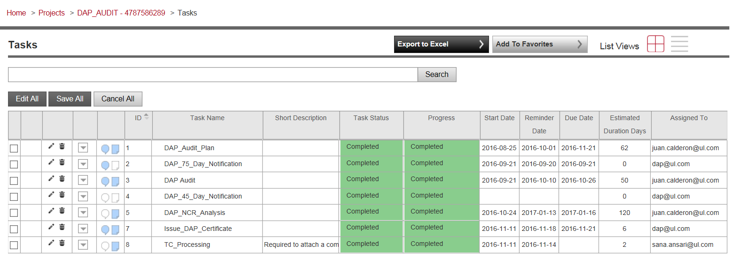
post-audit responsibilities – Flex tasks
DAP Tech Auditor
DAP Tech Auditor
Slide <number>
Notes:
Here is a view of the Flex project template for DAP Audits. Next we’ll see another view of the dap audit tasks in Flex.

Slide 46
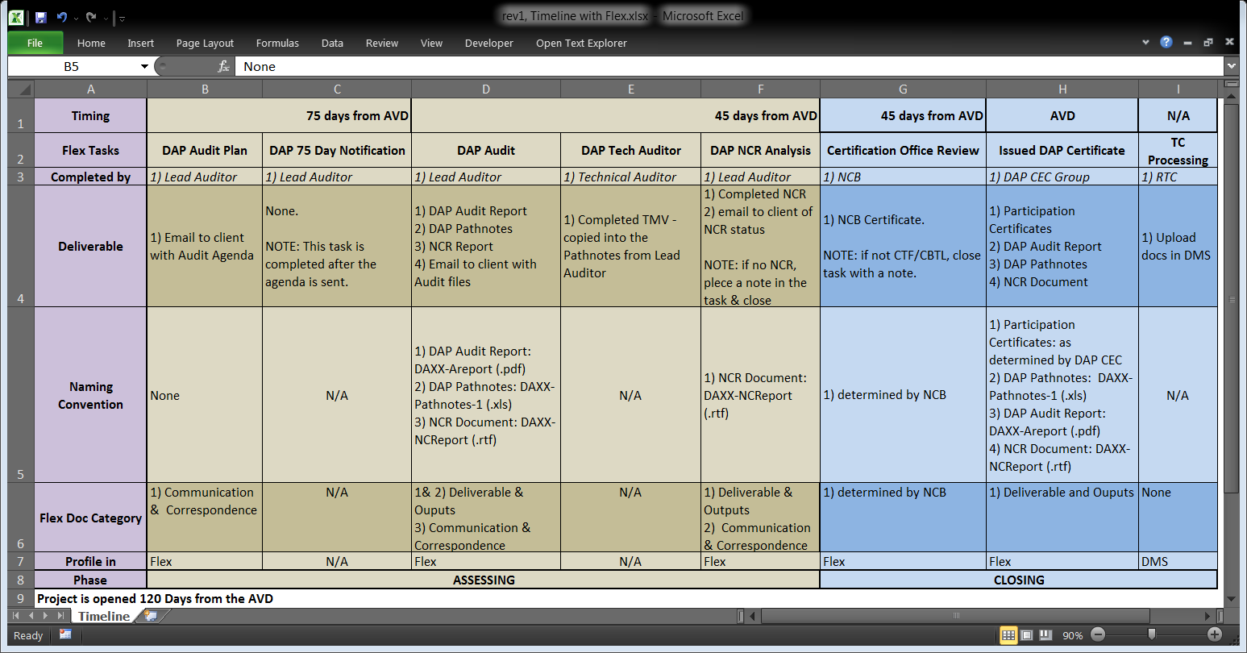

DAP Audit
  Covers the completion of the on-site audit.
  Deliverables – DAP Audit Report, DAP Pathnotes and NCR Document (if applicable)
  Complete once the visit has been completed and proper files provided to the client.
  Deliverable provided at the closing meeting or no more than 5 business days after the closing meeting.
  The e-mail sent to the lab with the audit documents gets profiled in Flex
Slide <number>
Notes:
Restate the above. If docs were given during the audit, place a comment in the notes section of this task.

Slide 47
DAP_Tech_Auditor
    Technical Auditor to complete this task after the assessment.
    If you are the Lead and are also acting as the Technical Auditor, you can assign it to yourself and complete the task.
Slide <number>
Notes:
This task assigned to the Technical Auditor to complete; if you’re doing both roles, assign it to yourself. You will copy the Test Method Validation (TMV) checklist into the Pathnotes, so no document is attached to Flex in this task.

Slide 48
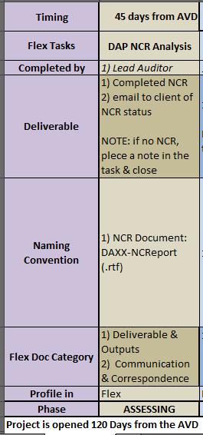
DAP NCR Analysis
  Covers the analysis of the client’s response to the NCR report. If no NCRs were issued, place a note in the task & complete it.
  Confirm Corrective Action acceptance via e-mail and indicate the status of each NCRs: closed or verified next annual assessment.
  Place the e-mail in FLEX under “Communications and Correspondence”.
  Auditor can authorize an additional 7 calendar days if client needs more time.
  If acceptable responses are not received after various attempts, escalate to the DAP Audit Manager to determine the next steps.
  Deliverable - Completed NCR Document in FLEX under “Deliverables and Outputs”.
Slide <number>
Notes:
Per the Feb 2017 LA call:
• DAP Tech Auditor =ECD-45 Days
• DAP_NCR_Analysis: = ECD-18 days) ( 27 days for Task duration)
• Certification_Office_Review :”.=ECD-11 days ( 7 days for Task Duration)
• Issue_DAP_Certificate : =ECD-7 days ( 4 days for Task Duration)
• TC_Processing =ECD-1 day ( 6 days for Task Duration)

Slide 49
Evaluating NCR Responses
  Activity – Class follows with their NCR report to review response areas.
Slide <number>
Notes:
Have everyone turn to their NCR report to discuss Page 2 of the form where the client responds.
Discuss 5 Why analysis approach - Ask: Do you know of other analysis methods? (fishbone, pareto diagrams)
Ask: What is a “Root Cause”?
Discuss responses.
Ask: What is “Direct Cause” (or Apparent Cause, Immediate Cause )?
Discuss responses.
Ask: Can you give me an example of Root Cause and Direct Cause?
DC examples: Equipment broke down and was replaced with equipment out of calibration. Used the wrong test samples. Technician did not know the correct method to run the test.
RC examples: Out of calibration equipment not properly controlled. Process does not ensure proper labeling of samples. Training program does not ensure training effectiveness. (MOST OF THE TIME IT IS PROCESS/SYSTEM RELATED).
Ask: What is Short Term Corrective Action?
Discuss responses. Quick fix. Containment.
Ask: What is Long Term Corrective Action?
Discuss responses. Eliminating the possibility of recurrence.
Ask: Can you give me an example of Short Term vs. Long term:
Short term: Re-run the test using the correct method, test samples, test materials, equipment, etc. Conduct a trace back analysis to see if any past data submittals were affected.
Long term: Revise the process and procedures. Re-evaluate the training program and maybe retrain personnel. Long term typically involves making changes to the system.

Slide 50
NCR Response Review and Close
Element | Observation | Finding
Summary of Root Cause Analysis |  | X
Concise Root Cause Statement |  | X
Corrective Action(s) | X | X
Anticipated Date | X | X
Objective Evidence | If available, not required | If available, not required
Can the NCR be closed? | Yes – If evidence of the fix is submitted and acceptable. | No – Must be evaluated at next audit.
NOTE: Client may submit objective evidence in an attempt to close the Observation NCR. However, don’t jeopardize the AVD waiting it.
Slide <number>
Notes:
Actions do not need to be implemented before closing the audit project.
Feel free to use a flip chart to record class responses when discussing the next terms:
Ask: Can you give me an example of Root Cause and Direct Cause (or Apparent Cause, Immediate Cause)?
DC examples: Equipment broke down and was replaced with equipment out of calibration. Used the wrong test samples. Technician did not know the correct method to run the test.
RC examples: Out of calibration equipment not properly controlled. Process does not ensure proper labeling of samples. Training program does not ensure training effectiveness. (MOST OF THE TIME IT IS PROCESS/SYSTEM RELATED).
.
Ask: Can you give me an example of Short Term vs. Long term corrective action?
Short term: Re-run the test using the correct method, test samples, test materials, equipment, etc. Conduct a trace back analysis to see if any past data submittals were affected.
Long term: Revise the process and procedures. Re-evaluate the training program and maybe retrain personnel. Long term typically involves making changes to the system.
Implementation verification: Steps taken to ensure the corrective action was implemented - objective evidence (revised procedure, training record, calibration certificate etc.)
Effectiveness verification: Steps taken to verify the corrective action is effective. This is different from the previous verification; the focus here is that the root cause has been eliminated and the NCR will not repeat.
NCRs are typically closed at the next audit since on-site evaluation is often required.
IMPORTANT: DAP typically sees the lab close the NCR in their internal database simply based on the fact the action has been taken. Effectiveness is assumed without evaluation. UL conducts an effectiveness evaluation but the client lab must also conduct their own!
SUMMARIZE: Remind class again that an action plan is all that is needed to complete the project. Evaluating effective implementation and closing NCRs is typically done at the next audit. The project must be completed by the AVD and cannot be held open waiting for objective evidence.

Slide 51
How do you get to final Root Cause (RC)?
►Sufficient Analysis◄
Get the right people involved:
  Who was there when the problem occurred?
  Who understands the system or process involved?
  Who has the skills to help you?
  May need the process or policy owner
  May need manager if problem is widespread
Choose a method to analyze the problem
  “5 Why” in NCR Report form
  Others?
Record thought process used to arrive at RC on NCR Report Form:
  Summary of Root Cause Analysis
  Concise Root Cause Statement
Notes:
To summarize, a good analysis is required to get to an appropriate RC.
To do that, get the right people involved – quickly go through questions to help client.
Choose a method to analyze the problem. While the NCR report form guides clients with the “5 Why” approach, what are other methods clients can use? Get participants to identify…
EXAMPLES:
Fishbone Diagrams – visual method to organize ideas and see relationships
Pareto Diagram – a graph to see how often the nonconformance occurs for a variety of causes guessed
Brainstorming – to gather lots of ideas from stakeholders
8D - http://asq.org/learn-about-quality/eight-disciplines-8d/index.html
And finally, document the thought process. There needs to be a logical link from the requirement to the nonconformity to the root cause.
Remember, DAP requires 2 things with the RCA – a) a summary of the analysis AND b) a concise root cause statement.

Slide 52
Explore these Root Cause Statements further
  “Restatement of the nonconformity”
  “Not aware of the requirement / Did not understand”
  “Inadequate training”
  “Potential / Possible”
  “This is not a finding”
  “Isolated incident/ Item overlooked”
  “Person left the company”
  “Human error”
Tips:
  Keep asking “Why” - It may be more or less than 5.
  If you think you are done, ask one more “Why?”
  Is it a “Root Cause” or an excuse?
Notes:
Clients are still having issues arriving at an appropriate root cause. These are the ones we typically receive.
You are a resource! Work with clients to further explore if you get these as a response. They are typically not the final RC!
Go through each RC and explain what to ask the client.
Most answers will be “Why?” or “This needs to be investigated further.”
Quickly read through the Tips.
EXPLAIN Let’s be proactive. Show clients the new NCR form and RC analysis while onsite (i.e. opening/closing meeting).
Discuss the requirements and set the client up for success!
We have to be careful not to provide the corrective action answers, but we can coach them through the analysis phase.

Slide 53
Corrective Action Response Review (continued)
If response is acceptable:
    Record acceptance in NCR report, email client, profile in Flex
    Activate Issue Certificate Flex Task at least 1 week before AVD
If response is not acceptable:
    Contact client to resolve issue
    Provide additional time for revision, with consideration of AVD!
Contact DAP Audit Manager if:
    Response not received
    Response is deemed unacceptable
    NOTE: DAP Inactivation (00-OP-S0055) might be initiated
Slide <number>
Notes:
Work with the client to obtain acceptable corrective action responses.
If unacceptable, be specific when emailing and when possible, call the client to get on the same page. Revised responses most likely come back acceptable when a call has been conducted.
Always keep the AVD in mind, communicate the timeline, and set an appropriate deadline to receive the revised corrective action responses.
ASK: What are examples of NCRs that may have impacted test data previously submitted?
Something that resulted in incorrect testing methodology
Incorrect equipment accuracy
Competence of personnel

Slide 54
Module 14 – Activity 1, Case Study, NCR Response Review
Directions:
  In your team, review the responses NTL provided.
Determine the following:
  Is the response acceptable? Why or why not?
  Do you need more information?
  What would you communicate to the client?
Time:
25 minutes - Team Review
20 minutes - Debrief
Slide <number>
Notes:
Review the directions with the class.
Distribute corrective action responses handout.
Be sure to ask each team for responses when asking the questions above for each NCR.
Instructor Answer Key:
NCR 1 – Purchasing
NTL’s Analysis and RC acceptable. Response is OK – would be better if it mentioned how personnel were notified of changes to the procedure to implement a change in daily lab process/operations.
NCR 2– subcontracting
NTL’s response is OK but could an improvement be made to the system – does a procedure or training need to be revised?
NCR 3 – Datasheets (Test Method)
NTL’s response is acceptable. Although the summary is bit short, the root goes into great detail (maybe too much).
NCR 4 – Equipment
NTL’s response is acceptable. They address current and future testing, past data submitted to UL (though the reason for this would be helpful), how to prevent recurrence and the final effectiveness check.
NCR 5 – Test Method & Equipment
NTL’s response is OK but could an improvement be made to the system? Calibration sticker and tamper seal separate? Root cause summary is weak. The root cause alsmost restates the problem, or only asks the 1st ‘Why?’

Slide 55
Module Summary
Lead auditor post-audit responsibilities
Client responsibilities in responding to NCRs
Analysis summary, root cause, direct cause, short-term, long-term corrective action
Accepting versus closing the NCRs
Slide <number>

Slide 56
Questions?

Slide 57
DAP Audit Review and Project Completion
Module 15
Notes:
Indicate this module covers the review process and Certificate issuance.
The steps completed by customer service will only be mentioned briefly since the focus is on the auditor’s and reviewer’s responsibility.

Slide 58
Learning Objectives
Explain the purpose of conducting reviews
List requirements looked for during review
Describe review outcomes and next steps
Slide <number>

Slide 59
Purpose of Conducting Reviews
To protect the UL Mark by ensuring compliance with UL DAP Policies and Procedures
To provide feedback and allow for DAP process improvement
To ensure reports support the recommendation made by the audit team through an independent review
Becomes objective evidence to grant or continue DAP participation
Slide <number>
Notes:
Other reasons include: to avoid major CAR from our accreditors.
The reviewer cannot be part of the audit team. It must be an independent review.
Evidence MUST support the final decision.

Slide 60
DAP LA Performance Review
  Reviews are done after the project is completed, on a sample of the projects completed by each auditor.
  The review is a performance review vs. a project review.
  Scopes reviews: most issues have to be corrected by the lead auditor.
Notes:
(Read highlights from above.) As part of maintaining your qualification for DAP, …

Slide 61
Items Checked During Review
Was the project completed by the AVD?
Were appropriate ISO 17025 clauses audited (3-year cycle or all)?
Were appropriate tests audited?
Were comments included as needed to explain deviations (e.g., exceptions to requirements, removing tests, etc.)?
Were applicable checklists and required documents completed properly and as needed (GALO, In-house calibration, CTF, CBTL, TMV checklists)?
Were prior year NCR’s reviewed and processed as required?
Were NCR’s clearly written and client responses appropriate?
Are there significant issues that require review by management?
Slide <number>
Notes:
(Read highlights from above.) appropriate actions will be required to address concerns

Slide 62
Top Issues DAP Reviewers Find
DAP Scope Database: Does not match Post Audit Scope report
GALO: N/A used without comment recorded, blank rows
Naming Conventions: Incorrect names or document format
DAP Assessment Tool (Pathnotes): Not filled out correctly, missing or inconsistent information
NCRs: Written as Observation vs. Findings (or vice versa), incorrect clause used
Corrective Action Responses: Accepted when inadequate or incomplete
Timeline: Lead Auditor or audit team delay – wait 2 months to start, becomes rush project!
Notes:
Facilitate discussion and answer questions so LAs have knowledge to prevent issues during review.

Slide 63
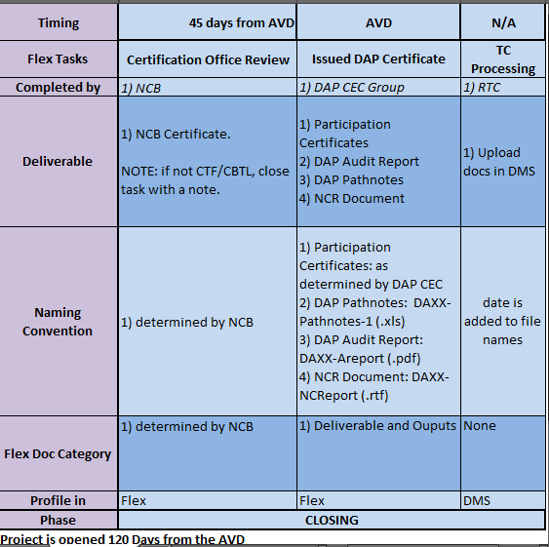
Closing Steps
Slide <number>
Notes:
the closing phase steps we’ll be reviewed , even though the auditor has minimal activity for these since we want to show you how the process/project finally closes.

Slide 64
Certification Office Review
All CBTL, CTF, PWT Projects must be routed to the corresponding NCB/ExCB.
A list of NCB representatives is located on the Quality Engineering website.
If more than one NCB/ExCB is required, add an additional task for each additional NCB or ExCB.
Assign the task to the NCB/ExCB with a due date to allow for the Certificate to be issued.
If the project is not a CBTL, CTF or PWT Project, complete this task with a note.
Deliverable: Participation Certificate – if applicable (i.e., CBTL, CTF, or PWT audits).
Slide <number>
Notes:
Per the Feb 2017 LA call:
• DAP Tech Auditor =ECD-45 Days
• DAP_NCR_Analysis: = ECD-18 days) ( 27 days for Task duration)
• Certification_Office_Review :”.=ECD-11 days ( 7 days for Task Duration)
• Issue_DAP_Certificate : =ECD-7 days ( 4 days for Task Duration)
• TC_Processing =ECD-1 day ( 6 days for Task Duration)

Slide 65
Issued DAP Certificate
Once the Certification Office Review task has been completed the DAP Lead Auditor should assign this task to the DAP CEC Group.
Assign this task to DAP@ul.com.
DAP CEC Group will confirm all required documents are attached and issue the Participant an updated Certificate.
Slide <number>
Notes:
Per the Feb 2017 LA call:
• DAP Tech Auditor =ECD-45 Days
• DAP_NCR_Analysis: = ECD-18 days) ( 27 days for Task duration)
• Certification_Office_Review :”.=ECD-11 days ( 7 days for Task Duration)
• Issue_DAP_Certificate : =ECD-7 days ( 4 days for Task Duration)
• TC_Processing =ECD-1 day ( 6 days for Task Duration)

Slide 66
TC Processing
The DAP CEC Group will make this task active once they have completed the Issue DAP Certificate Task.
Once this task is completed by the RTC, the project will be closed.
Slide <number>
Notes:
Per the Feb 2017 LA call:
• DAP Tech Auditor =ECD-45 Days
• DAP_NCR_Analysis: = ECD-18 days) ( 27 days for Task duration)
• Certification_Office_Review :”.=ECD-11 days ( 7 days for Task Duration)
• Issue_DAP_Certificate : =ECD-7 days ( 4 days for Task Duration)
• TC_Processing =ECD-1 day ( 6 days for Task Duration)

Slide 67
Questions?

Slide 68
DAP Inactivation
Module 16
Notes:
We’ve mentioned multiple times the importance of completing the audit project by the AVD and how to do so. Let’s learn more about this process and how to keep clients ACTIVE!

Slide 69
Learning Objectives
Understand reasons for Inactivation
Explain the required steps for Inactivation
Describe the process for reinstatement
Slide <number>
Notes:
Inactivation & Withdrawal can occur at any time and are not limited to a post audit activity.
Some of the steps in this process are completed by customer service. Indicate that they will only be mentioned briefly since the focus will be auditor’s responsibility.

Slide 70
Reasons for Inactivation
Unacceptable audit result (severe NCR)
Unresolved Corrective Actions taken on an NCR (past or current)
DAP Audit not completed by the anniversary date (AVD)
A systemic non-conformance identified by CAS to Data Recording, Reporting and Related Requirements
Failure to comply with the terms of the L56 agreement (DAP Service Coordinators determine)
Client request, not based on audit
DAP Participant Inactivation, 00-OP-S0055 &
DAP Assessment Report
Slide <number>
Notes:
Give examples; ask for input.
In the next slides, we will focus on the bolded items only since these are typically where the lead auditor will get involved.

Slide 71
When Inactivation is Recommended at the Audit
Discuss with audit team
Inform client of recommendation
Contact DAP Audit Manager for agreement
    Engineering Manager is contacted if DAP Audit Manager agrees
    Also Channel Program Manager for TPTDP or PPP participants
Document decision in Assessment Report (Areport)
Indicate the client has 10 business days to respond to applicable NCRs
DAP Participant Inactivation, 00-OP-S0055 &
DAP Assessment Report
Slide <number>
Notes:
It is important to discuss with the entire team before making any decision regarding Inactivation. If additional input is needed, contact a reviewer or another auditor to get a ‘fresh’ perspective.
Explain the possible Inactivation to the client, and give them a chance to present additional information that might clear up the problem.
Advise the client that NCR responses are required in 10 days (not 20).
Make sure that the audit report reflects the recommendation for Inactivation.
Inform the client that a Special audit is required if unable to verify implementation/effectiveness in the office.
It is critical to get the audit documents reviewed ASAP.

Slide 72
Inactivation process
  The lead auditor informs the DAP manager of their recommendation.
  If the DAP Manager agrees, he/she sends an email to DAP@ul.com with a request to suspend in our system.
  At that point the client reverts to WTDP or testing at UL until all NCRs are resolved and based on severity, fully implemented.
  Any data generated under DAP before the suspension date (date of audit) can be accepted but any data during suspension will have to be either witness testing or done at UL.
  If resolution is done before their next anniversary, then partial audit is conducted based on what needs to be fixed. If after then, a full audit is conducted.
Notes:
(Read highlights from above.)

Slide 73
Inactivation Status & Reinstatement
DAP Service Coordinator will update Oracle, notify CAS & client of change in status to Inactive
Under Inactivation, client cannot test or submit data to UL
Clients have up to 120 days to resolve the NCRs
        Special assessment may be conducted onsite
Reinstatement requires resolution of all NCRs that created the Inactivation (DAP review of effective implementation)
Slide <number>
Notes:
Indicate only 2 statuses in DAP: Active = can test & submit data, Inactive = Suspended
Client has 120 days to fully implement corrective action plans.
If you have time, ROLE PLAY by INSTRUCTORS:
NOTE: Instructors explain they are going to provide a role play for the class to observe. It should simulate a situation where one person is the auditor and the other is the client learning they are going to be suspended. The auditee should have a negative reaction to this news. The role play should last about 5 minutes.
Auditor Role - demonstrate all or most of the skill sets that have been discussed during the course:
Be cooperative
Be pleasant
Communicating clearly
Be empathetic
Ask questions
Listen
Present complete information
And any others that you feel might be appropriate based on your past experience
Auditee Role - demonstrate an encounter that will test the skill sets that have been discussed during the course:
Lose your temper
Interrupt while the auditor is talking
Intimidate the auditor
Demand answers to your questions
And any other that you feel would present a challenge to an auditor in this situation
Debrief to offer insight on how to handle such situations. Be sure to ask questions that require the class to reflect upon what they could do to defuse the situation and make it one they can control.

Slide 74
Questions?

Slide 75
Power Quality Analysis Determination
Module 17
Notes:
Ask class if they have taken the WTDP refresher course to evaluate how to train this module (in full or scan through)
If they already took the course, Instructor can ask those staff to answer more questions to gauge their knowledge/test them.

Slide 76
PQA: Why & Who & What
Why: To ensure proper testing environment defined in standard so that test results are reliable and repeatable, incl. voltage regulation, frequency regulation and harmonic distortion
ISO/IEC 17025, clause 5.3 requirements: monitor, control and record test environment, including power sources.
    Who: Participants have the option of conducting PQA:
    Themselves or any 3rd party, including UL
What: Clients may record results using UL datasheets in 00-OP-C0036 or their own.
Notes:
Initial and ongoing testing of laboratory environments (including Power Quality) must be done to achieve results that are accurate and repeatable.
One major factor affecting reliable test results is having a proper testing environment within the parameters specified by the standard.
Along with an environment that typically includes a suitable ambient temperature and humidity, another important aspect is the power quality.
Voltage fluctuations with loads that cycle, or having significant distortion of the voltage waveform due to harmonics will affect consistency and repeatability of test results.

Slide 77
Technical Requirements / 00-OP-C0036
  Rule of thumb: If the test sample does not connect to a power source during testing, a power quality analysis is not required.
  DAP participants are required to conduct PQA every 3 years, or when changes could affect results
  Labs testing in these ranges require PQA:
    120 Volt AC, 60 Hertz, single-phase, up to 20 Amps
    230 Volt AC, 50 Hertz, single-phase, up to 16 Amps
    240 Volt AC, 60 Hertz, single-phase, up to 15 Amps
  Exceptions: Power sources having voltage or amperage ratings greater than the values given below or poly-phased circuits are to be monitored during performance of the tests:
  Document deviations using PQA Decision Form in 00-OP-S0056 when PQA typically applies but is waived by PDE/technical decision.
Notes:
There are certain product industries that will typically not require a power quality assessment, such as Water, Materials and Fire Protection.
A rule of thumb is if the test sample does not connect to a power source during testing, a power quality assessment is not required.
Test equipment power sources are also not required to have a PQA.
When PQA typically applies but is waived by PDE/technical decision, document the deviation using PQA Decision Form in 00-OP-S0056.

Slide 78
Summary
Why PQA is required for a DAP Participant
Who can conduct PQA
How are PQA results are documented
Notes:
A: UL labs and DAP participants must meet the requirements of ISO/IEC 17025, clause 5.3 including power sources.
A: DAP participant or any 3rd party. UL lab staff typically conduct the PQA, not DAP staff.
A: Go back to show technical requirements.
A:When conducted by UL, the Technical Auditor will utilize the UL PQA Datasheets located in Appendix A of the SOP (00-OP-C0036). Clients may choose to document their results using our datasheets or some other report they created. Since report formats may vary, UL Staff will need to validate report content against 00-OP-C0036 and DR&R requirements (00-OP-C0025).

Slide 79
Questions?

Slide 80
Lead Auditor Course Summary
Module 18

Slide 81
Course Agenda
Day | Topics
1 | Overview of the DAP Program & Requirements Your Case Study Assignment ISO/IEC 17025 – Introduction DAP Management Requirements (ISO/IEC 17025, Section 4)
2 | DAP Technical Requirements (ISO/IEC 17025, Section 5) Audit Overview and Client Deliverables Planning for the DAP Audit Conducting an Opening Meeting
3 | Conducting an Opening Meeting (continuation) Documenting the DAP Audit using the GALO, In-House Calibration Checklists & Path Notes Laboratory Audit Communicating Potential NCRs to the Auditee
4 | Writing NCRs How to Write a Audit Report Conducting a Closing Meeting Post Audit Responsibilities & Review of NCR Responses DAP Audit Review and Project Completion DAP Inactivation Power Quality Analysis Determination Lead Auditor Course Summary
Slide <number>
Notes:
Go through Course Objective:
Recognize the business case for audit practices at client labs
Determine applicable ISO/IEC 17025 clauses and DAP policies/procedures
Describe the roles and responsibilities of key personnel in an audit
Describe the audit process UL DAP uses
Understand the need to set target dates and impact Inactivation has
Determine and verify client audit requirements before the lab visit
Use DAP tools to plan for and complete the audit
Conduct an opening and closing meeting
Determine conformance or non-conformance
Apply audit principles to different client situations
Communicate and write NCRs effectively
Completing Post-audit tasks to keep the project moving
Evaluate client NCR responses
Explain the purpose of conducting reviews and list items to look for
Identify reasons for and required steps for Inactivations
Explain the process for reinstatement
Ensuring the lab has Power Quality Analysis completed

Slide 82
DAP Lead Auditor Qualification
COMPLETED: DAP Lead Auditor Training (classroom)
NEXT: Complete successful oversight DAP audit.
DAP Qualifier will mentor and evaluate you through all steps of an actual DAP audit project – onsite costs covered by your department
When audit is assigned, create Flex task for DAP Qualifier (optional)
DAP Qualifier will complete DAP Lead Auditor Oversight Form (00-OP-F0045 – review as class) - either to qualify or more training
Technical Competency Database updated with your qualification as level “12” (Lead Auditor) to “DAPA” (All Data Acceptance Programs)
Notes:
Explain the steps to obtain qualification as DAP LA.
At least show the oversight form to the class.
If time allows, discuss areas they will be evaluated on and how we covered those areas in the classroom training.

Slide 83
Maintaining DAP Lead Auditor Qualification
Positive DAP Review results
Min 3 audits per year
Attend (or view if missed) LA calls & complete ComplianceWire quiz.
See QE website for more details.
Notes:
Explain the steps to obtain qualification as DAP LA.
At least show the oversight form to the class.
If time allows, discuss areas they will be evaluated on and how we covered those areas in the classroom training.

Slide 84
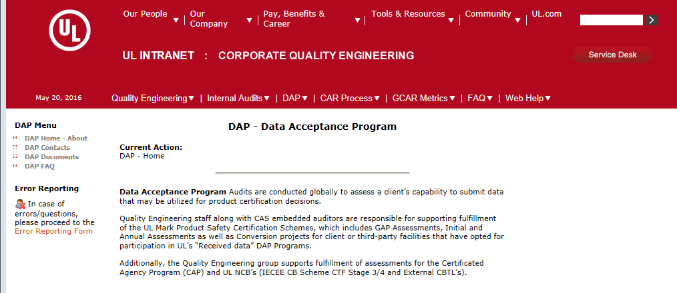
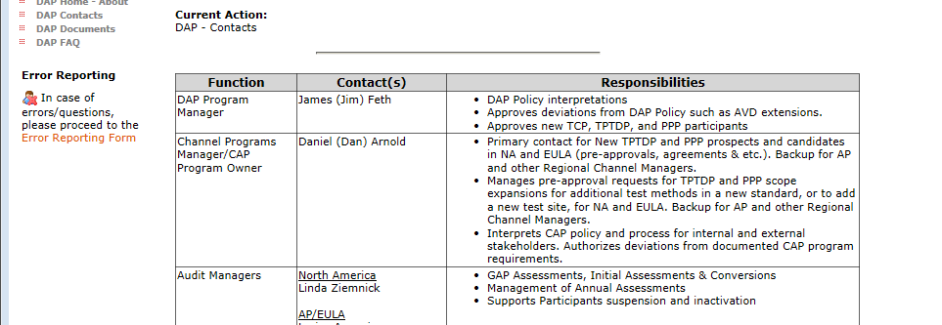
DAP Resources (Intranet)
DAP Home page – use link for latest
Slide <number>
Notes:
Walk class through finding additional DAP staff by clicking on “DAP Coordinators”.
Can also find DAP website by typing ‘DAP’ in the Intranet search field.

Slide 85
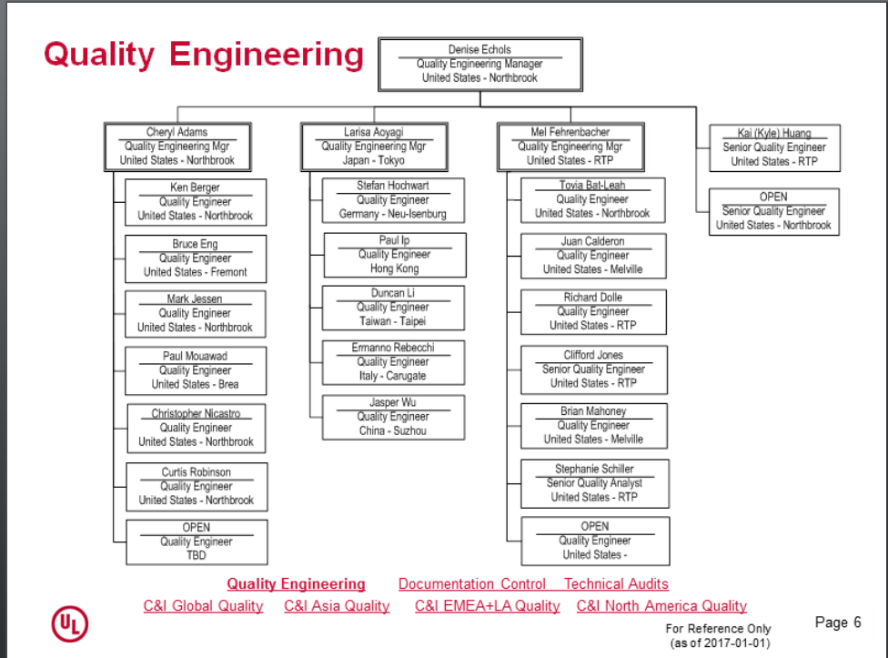
DAP Organizational Structure
Global Quality – use link for latest
Notes:
Click on hyperlink to Global Quality. Open “Global Quality Organization (pps)” link listed under “Organization” on the right-side pane. Select “Quality Engineering”.
Introduce DAP Core Team in NA (left) and AP/EU (right).
DAP Audit Maangers are: Linda Ziemnick (NA) and Larisa Aoyagi (AP/EULA).
Indicate DAP was it’s own department but as of October 2014, is part of corporate Quality Engineering.
All clients need to know is there is a “DAP Program”.

Slide 86
Responsibilities
DAP Program Manager: Jim Feth
Contact for:
  Requirement interpretation
  Client issues
  Special considerations
  Agreement deviations
DAP Audit Managers: Kai Huang (NA), Larisa Aoyagi (AP/EULA)
Contact for:
Audit fulfillment
Auditor related items
DAP Audit documentation/tools
Client Inactivation
Repeat NCRs
00-IC-P0026 & 00-OP-S0056

Slide 87
For more information, contact your
Regional DAP Audit Manager.
Internal DAP Site:
http://corporate.ul.com/departments/snk5212/DAP/DAP_Home.cfm
DAP Client Site:
ul.com/DAP
Slide <number>
Notes:
The website includes client guide documents, overviews for each type of participation, FAQs, announcements.

Slide 88
Final Questions?
Notes:
Distribute the course evaluation and ask them to complete it before leaving. Have them turn it in to you.
NOTE: Be sure you are getting one evaluation from each person
Re-emphasize that you appreciate their focus and participation.
Ask if there are any final questions.
Remind them that the DAP team is here to help. We know it is a lot of information to absorb and they will have the opportunity to complete an audit project step-by-step with the support of a Qualifier.
NOTE: Please send the surveys back to UL University for entering into their evaluation program: UL Headquarters, 333 Pfingsten Rd., Northbrook, IL 60062, USA.

Slide 89
CONGRATULATIONS & THANK YOU ! ! !
We want your feedback!
- Please complete the online course evaluation before leaving.
Notes:
Re-emphasize that you appreciate their focus and participation.
Ask if there are any final questions.
Remind them that the DAP team is here to help. We know it is a lot of information to absorb and they will have the opportunity to complete an audit project step-by-step with the support of a Qualifier.

